Slide 1
IATI TAG 2018
IATI & dashboards
Cooperation
ToC
Trust
M&E
Monitoring the results Dialogue & Dissent
Bottom-up
Guidelines
Methodology
Qualitative & Quantitative
Marie-Louise Wijne
Jelmer Kamstra
Pelle Aardema
Herman van Loon

Slide 2
Diversity of Dialogue & Dissent
25+ partnership organisations
30+ partner ToC’s / themes
60+ countries
5+ NMFA departments

Slide 3
Results Monitoring Approach Dialogue & Dissent
Qualitative & Quantitative
Bottom up, together with partners
Clear ‘story’ about what D&D is and achieves
Notes:
1 – process with MDF to construct RF based on your RF’s, matching of indicators
2 – Making sure that people understand and support what we are doing

Slide 4
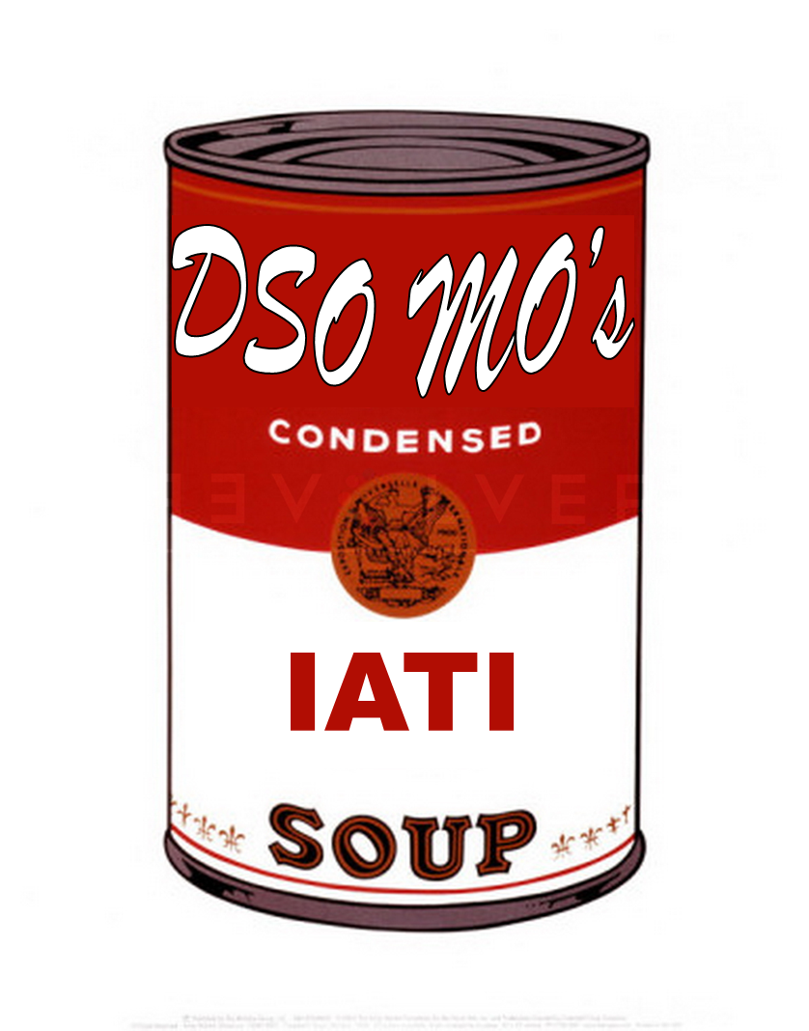
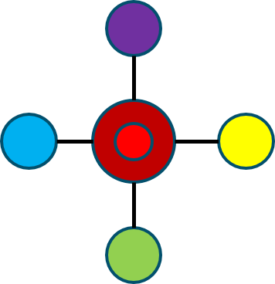
Road thus far
Partners developed their own result frameworks (up to 130+ indicators per partner)
Dialogue & Dissent ToC further developed
Exercise with consultant & partners → clustering indicators (30+ indicators)
Results report 2016 → selection of 8 indicators
Oct 2017 consultation with partners → 6 core indicators and additional guidance on reporting
Indicator

Slide 5
Framing quantitative results in the Theory of Change
Inclusive sustainable development in LLMICs
thematic departments
Improved laws, policies, norms, attitudes and practices
change on paper & change in behaviour
Towards improved laws, policies, norms and practices
agenda setting, framing and/or creating space to engage
Civil society Engagement
Advocacy initiatives
Civil society strengthening
Capacity & Legitimacy

Slide 6
Link between partners & MoFA results framework with DD indicators
Partners own results framework is leading
Match to overarching DD core indicators
Interpretation and operationalization up to partners: mutual trust is essential
The IATI trick
Using the IATI 2.03 results reference field or
Adding the reference code (DD1, …, DD6) to the indicator title or description (for IATI publishers using older versions of the standard)
Notes:
Key message: we do not enforce our own result framework and corresponding indicators on our partners.

Slide 7
Results over time
Expected
Period start Period end
1-1-2016 – 31-12-2016 Actual 2016
1-1-2017 – 31-12-2017 Actual 2017
1-1-2018 – 31-12-2018 Actual 2018
1-1-2019 – 31-12-2019 Actual 2019
1-1-2020 – 31-12-2020 Actual 2020
1-1-2016 – 31-12-2020 Running total 2016-2020
Notes:
Key message: since not all indicators can be aggregated over time, the running total is reported separately.
Issue for the standard: should we define more levels of aggregation (not aggregtable, aggregatable except over time, aggregatable.

Slide 8
Results at overall partnership (parent) level and subset (child) level
Avoid double counting: aggregation is the responsibility of the partnership (= level 1, others cannot and should not).
Can be automated based on aggregation status, but may lead to errors (example: different partners working on the same initiative)
Connect to your funder (IATI incoming transaction providing activity-id)
Level 0
MoFA
Level 1
Partnership
Level 2
Level 3
Notes:
Key message: our direct partners aggregate on behalf of all partners in the network. This restriction can be relaxed if one makes sure that result are being registered by the organization achieving them: all partners must publish in IATI

Slide 9
Dialogue & Dissent dashboard: bit.ly/DDresultsTest

