Slide 1
Institutional Review Update
IATI Members Assembly 2018
Institutional Review Working Group
07.11.2018

Slide 2
“
IATI MA 2017 Minutes
“...the working group should present recommendations regarding Secretariat structure, hosting and location, fee structure, board structure and working methods, and transition plan to the recommended option.”

Slide 3
Scope (from WG Terms of Reference)
The Working Group will provide decision support on:
The best model for Secretariat
Leadership of Secretariat
Governing Board arrangements
Legal status and implications
Location of Secretariat, costs
Transition process

Slide 4
Review Process

Slide 5
Progress on actions agreed in Rome
EoI for Consultant
March 2018
Institutional Review Working Group
launched
Dec 2017
F2F WG meeting NYC +
external consultant
Apr 2018
Diagnostic consultations
May 2018
WG analytical work
Jan 2018
Recommendations
June 2018
MA Rome
Oct 2017
MA CPH
Jul 2018
Notes:
The Institutional Review Working Group has been running regularly since December. Core membership of 19 people from all constituencies, with great participation on the 2-weekly calls.
We all agreed the Data Use Strategy in January following comments in the MA. Drafted an accompanying results framework and integrated into the Y5 work plan and budget.
Implementing the strategy has mainly focussed on the Data Use Fund:
31 Expressions of Interest from companies interested in accessing funding
3 RfPs issued
2 pending
Will talk more about our challenges later.

Slide 6
Ground Rules
Balance changes and risks
Avoid overburdening system
Recognize our limits
Structure, not personnel
Go beyond caucus perspectives
Bring closure to conversation

Slide 7
What We Did
Operated independently
Biweekly/weekly meetings
Two face to face meetings
Drew on members’ organizational experience
Used Powered by Data report and raw data as input
WG consulted Membership, Governing Board, and Secretariat

Slide 8
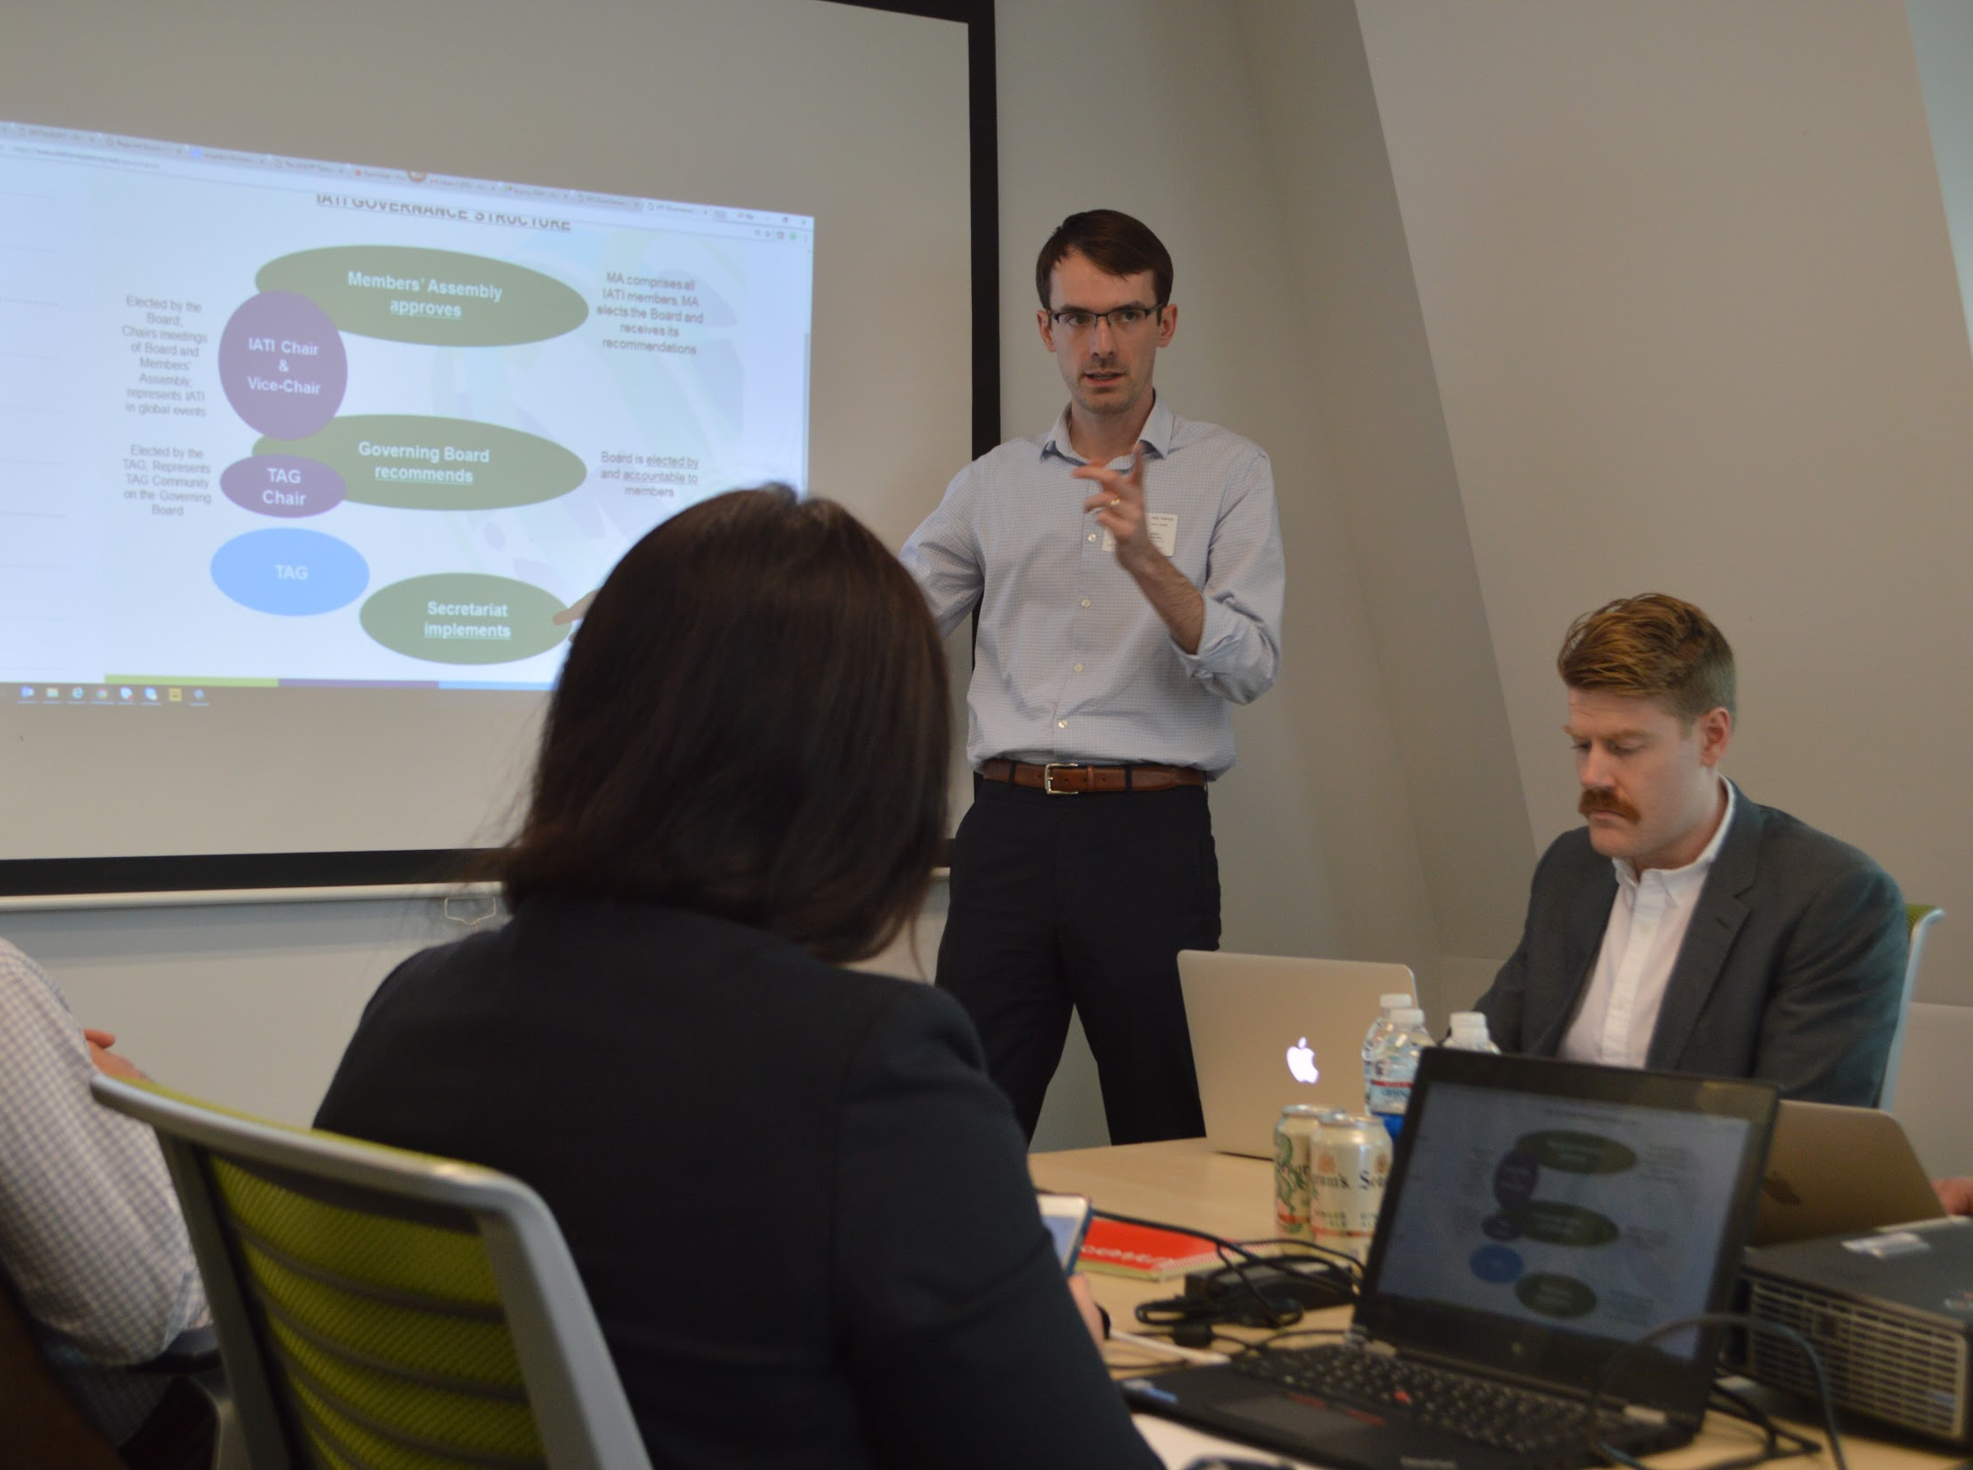
F2F Meeting in NYC

Slide 9
Findings of the Diagnostic

Slide 10
Key Finding IATI Formal Governance largely appropriate for a multi-stakeholder initiative (MSI) of this nature and size

Slide 11
Summary of Issues
Issue #1: Structural arrangements and ambiguous responsibilities have generated uncertainties and inefficiencies
Issue #2: Lack of formal, medium-term strategic plan hinders effectiveness
Issue #3: Cash flow shortages create further uncertainty
Issue #4: Management constrained by inadequate accountability mechanisms

Slide 12
Comparison of Two Options (Hosted vs. Independent)
Streamlined 4 options down to 2 for purposeful reasons
Enumerated costs, legal issues for 2 cities for practical reasons (hosted entity in New York, independent entity in Amsterdam)
Comparison criteria: political support, legal predictability, cost, travel accessibility, civic space, talent pool, infrastructure, etc.

Slide 13
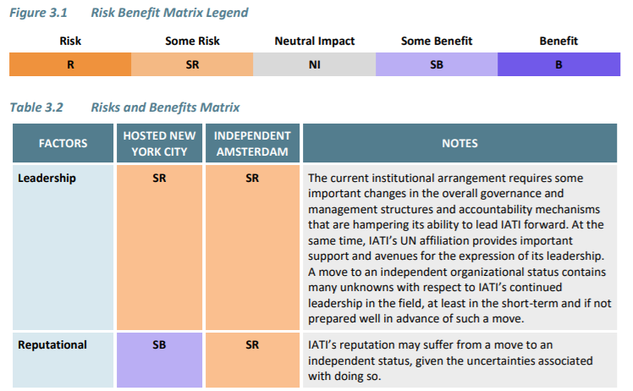
Risks and Benefits (Section 3.3, pp. 20-23)

Slide 14
Summary of Risks and Benefits (see report for more detailed analysis)
Flexibility
Reputation
Continuity
Bottom line: risks of independent entity outweigh benefits; hosted arrangement with key improvements is the preferred option
Notes:
Flexibility: staff hiring, contracting, advocacy, operations Reputation: funding, donor support, senior management staff hiring, political engagement Continuity: operations, management, funding stability, membership, institutional knowledge, learning, in-process changes

Slide 15
Recommendations of the Working Group

Slide 16
Summary of Recommendations
Recommendation #1: IATI should retain its UN-based, hosted institutional arrangement for the 3-year period from 2019-2022.
Recommendations #2: IATI should develop a strategic plan to define its medium-term strategic direction and inform the accountability and institutional arrangements starting work after 2018 MA.
Recommendations #3: IATI’s governance should be restructured to resolve governance ambiguities.
Recommendation #4: The value-for-money proposition for membership should be revisited.

Slide 17
Issue #1: Lack of clear responsibility lines
Rec #3: Restructure IATI’s governance to resolve governance ambiguities.
3.1 Members’ Assembly: Consider and sign off the strategic plan (no longer approve annual workplans)
3.2 Governing Board: Should have no operational role; should be responsible and accountable for oversight and agreement of annual workplans and budget
3.3 Secretariat: More executive and accountable leadership role, beyond that of ‘coordination’; accountable to the Governing Board for institutional (operational and technical) progress and functional performance

Slide 18
Other suggestions on responsibility...
Clarify resource mobilization responsibilities beyond the collection of membership dues.
Ensure clearer and more direct accountability of the communication function to the Head of Secretariat, including physical co-location in New York.
Ensure clearer and more direct accountability of core functions to the Head of Secretariat, with technical progress communicated more regularly and accessibly with the wider, more generalist Members of the IATI community.
Hire a Chief Technology Officer.

Slide 19
Issue #2: No medium-term strategic plan
Rec #2: IATI should develop a strategic plan to define its medium-term strategic direction and inform the accountability and institutional arrangements starting work immediately after the 2018 Members Assembly.
2.1 Immediately following the 2018 Members Assembly, work should begin on developing a 3-year strategic plan, for review and endorsement by the 2019 Members Assembly. The strategic planning exercise should guide IATI’s future institutional arrangements beyond August 2022 and financing strategies.
2.2 A monitoring, evaluation, and learning system should be established

Slide 20
Issue #3: Insufficient, unpredictable financing
Rec #4: The value-for-money proposition for membership should be revisited
4.1 While membership contributions are an appropriate way to sustain IATI, the value-for-money of membership, and the contribution structure, could be adjusted.
4.2 A membership task force could be empowered to articulate the value proposition for each membership category.
4.3 A resource mobilization strategy that includes membership contributions and non-membership based resources could be considered.

Slide 21
Issue #4: Lack of clear accountability lines
Despite the accountability ambiguities…
Everyone in the current arrangement demonstrated exceptional ability to work productively
Some changes already underway between Governing Board and Secretariat
Tech team long-term workplan and prioritization proposal a step forward

Slide 22
Issue #4: Lack of clear accountability lines
Rec #1: IATI should retain its UN-based, hosted institutional arrangement for the 3-year period from September 2019 onwards
1.1 Follow through with the extended hosting arrangement until 31st August 2019.
1.2 Secretariat should revisit the merits and limitations of the current arrangement and make immediate adjustments to improve its functioning as suggested
1.3 As of 1st September 2019, the Secretariat should be streamlined along vertical lines and formalized, with UNDP as its primary institutional home until 31st August 2022

Slide 23
Transition

Slide 24
Roadmap
2018-2019
Board and Secretariat implement necessary changes within current arrangements
3-year strategic plan developed and endorsed at 2019 MA
Board negotiates details of new arrangements
Transition to new arrangements effective Sept 1 2019 (or January 2020)
2019-2022
3-year strategic plan in force, operationalized through annual work plans
Arrangements for 2022 and beyond to be informed by the strategic plan

Slide 25
Any clarification questions?
(Note that small group discussion on the content of the recommendations will follow)

Slide 26
Key Asks
The Working Group requests the Members Assembly to:
Adopt recommendations 1-4 of this review.
Mandate the Governing Board to implement these recommendations within a specified timeframe.

Slide 27
Small Group Discussion
Do you agree with the overall directions of the four recommendations?
Retain the UN-based hosted arrangements with strengthened accountability mechanisms until August 2022
Develop a 3-year strategic plan
Restructure and streamline governance (MA, Board and Secretariat)
Revisit the value-for-money proposition
What are your reactions? Do you see major risks or potential roadblocks?

Slide 28
Thank you!

