Slide 1
UNDERSTANDING ACCESS AND USE OF IATI DATA
OPEN DATA WATCH
2 March 2021
Notes:
Eric to speak here.

Slide 2
TO PROMOTE THE SYSTEMIC USE OF IATI DATA
Our research combines results from an INVENTORY OF TRAINING MATERIALS, IATI GOOGLE ANALYTICS, a USER SURVEY, and FOCUS GROUPS with IATI data users to distill insights for improving the access and use of IATI data.
Notes:
Eric
ODW took a multi-pronged approach to evaluate barriers to use of IATI data by: evaluating the availability of training materials through an inventory of training materials; analyzing Google Analytics to understand patterns of data use, and engaging with key IATI users through a survey and focus group.
The final results of this work are available in our report on the subject but this presentation will bring out some of the highlights from the report and outline the challenges and opportunities to increasing IATI data use.

Slide 3
INVENTORY OF TRAINING MATERIALS
What resources and tools exist to help users access and use IATI data?
15 IATI training materials
27 IATI data use tools
Most examples of training materials included in the inventory were user guides, but also included a video, webinar, and online training course.
Access the INVENTORY here.
Notes:
Caleb
ODW started the research process by creating and inventory of IATI training materials and data use tools. This collection of training materials and tools are available through the link on the slide.
Data-use tools are portals, apps, or websites that use IATI data to provide a service or provide access to IATI data. Along with training materials, these resources are another tool that can facilitate IATI data use.
It’s also important to note that this inventory is on tools and training materials for IATI data use and not for publishing IATI data.
The results of this inventory were designed to highlight gaps in training materials and data-use tools that could be limiting data use. We found 15 training materials and 27 iati data use tools and more insights are available in the final report.

Slide 4
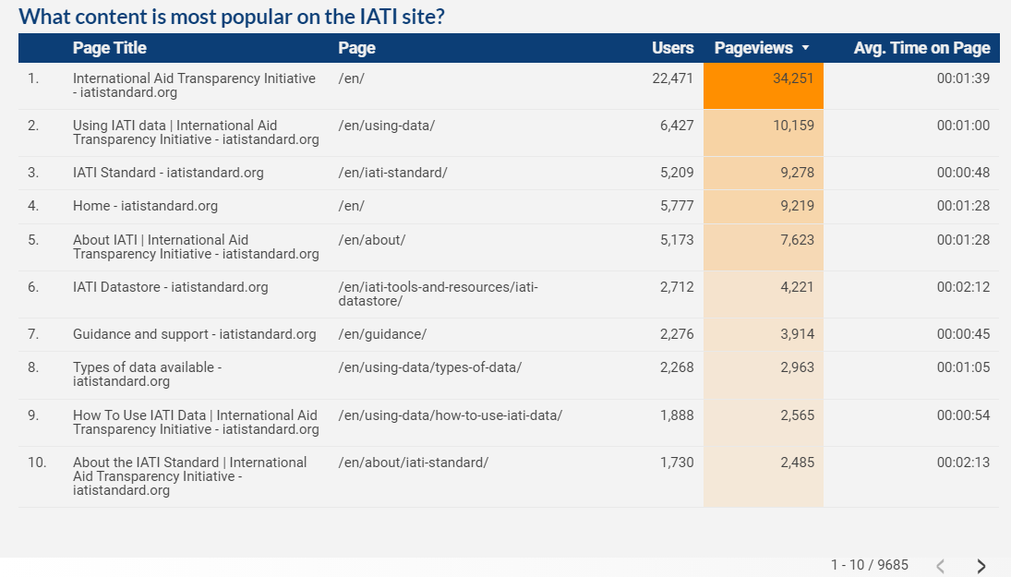
IATI GOOGLE ANALYTICS
These data show a significant user-demand for IATI training materials.
Notes:
Caleb
The ODW team reviewed IATI’s google analytics to understand how IATI data and resources are being used on the IATI website, D-Portal, and Query Builder
Google Analytics can help give us many important insights into user behavior on website like what is the most popular content on the site? What is driving traffic to the website? And who is using the site?
This page is a screenshot from a Google Analytics dashboard that we created for the project that provides insights on answer questions about IATI website and data use.
The numbers on this and the following slides are all from the last calendar year from January 1st, 2020 to December 31st 2020. ON the dashboard, however, you can adjust the time to view any period of time.
This page shows how many people are visiting different parts of the IATI main website and how much time they are spending on it. if you look here you’ll see that after the home page, the most popular page on the website is on a training material on how to use IATI data (#2). You’ll also notice that many other of the most popular pages are related to training: #5 About IATI, and 7,8,9, and 10.
This speaks to the demand for IATI training materials.

Slide 5
IATI GOOGLE ANALYTICS
The Google Data Studio Dashboard presents website analytics from the IATI website, D-Portal, and Query Builder.
IATI Main Website
Access the Google Data Studio Dashboard here.
IATI D-Portal
Query Builder
Notes:
Caleb
At a bigger level and across all IATI sites, we can see how people are engaging with the different IATI tools.
The first thing to note is the large number of users who visit these sites, which speaks to the importance of IATI data and the demand for it.
This slide also provides insight into how the IATI user base accesses data, the D-portal is by far the most popular site, but Query builder tends to have fewer (probably more advanced) users but they spend more time on the page.
This could be useful information for planning what website changes to prioritize by understanding the traffic.
You will also notice the percentages below each number, these are also in the dashboard and can be used to understand how these numbers relate to past performance numbers.
These percentages are often best put into context by people who understand the website changes, as they can note when redesigns and other upgrades were put in place and provide context to the shifts in traffic.
There is a link on the right side of the page to access the data studio dashboard if you would like to at a later date.

Slide 6
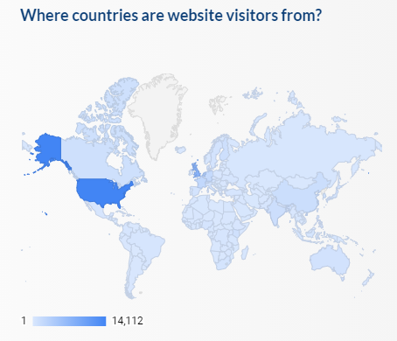
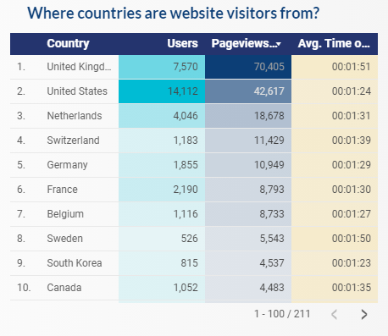
IATI GOOGLE ANALYTICS
These analytics show patterns of access and use of IATI data. They show where users come from, what pages users access, how they access them, for how long, and much more.
The IATI Google Analytics show that most users come from high-income countries.
Trends from main IATI website hold true for D-Portal and Query Builder.
Notes:
Caleb:
Analytics can also tell us who is accessing IATI data and from where.
This is data from the IATI main website, but the other sites have a similar pattern.
We found that most IATI users for the website are from high-income countries: UK, US, Netherlands, Switzerland, and Germany.
This page is useful for IATI to help understand the efficacy of efforts to broaden the IATI user base into lower-income countries or to monitor how national actors are using the data to track spending and operations in their countries.

Slide 7
Google Analytics can provide the IATI Data Users Working Group with real-time information to better understand and facilitate IATI data use.
Notes:
Caleb:
There are many more insights in the Google Analytics to understand IATI data use and potential improvements to facilitate data use on the dashboard, including what sources are driving traffic to the site, what google keywords the site is ranking for, and what languages website users are browsing in.
However, data are only valuable when they are used, and that definitely applies here. We would encourage the IATI data use working group to not just review this dashboard once, but think about how they can incorporate a review of these data into their regular meetings and procedures to better understand their users and facilitate IATI data use in the long term.

Slide 8
USER SURVEY and FOCUS GROUPS of IATI users
Experiences from 30 USER SURVEY respondents and 14 FOCUS GROUP participants highlight common challenges to using IATI data platforms.
DATA QUALITY
DATA GAPS
TECHNICAL CHALLENGES
NEED FOR GUIDANCE
Notes:
A vibrant community of passionate users participated in the surveys and focus groups, sharing a wide range of experiences.
Some participants were advanced IATI users while others were still new to it.
The user surveys included experiences from a total of 30 respondents and a total of 14 IATI data users participated in the focus groups.
We contacted these respondents through the IATI mailing list as well as Open Data Watch’s twitter and country national statistical office contacts.
Participants in the surveys and focus groups highlighted many common challenges to using IATI platforms and made many suggestions for improvements.
We have organized our findings in four main areas: data quality, data gaps, technical challenges, and need for guidance.

Slide 9
DATA QUALITY
This is what USER SURVEY respondents and FOCUS GROUP participants said:
Participants who work directly with countries said partners did not recognize their data from internal records.
Duplication of commitments between funders and implementing partners.
Some publish cumulative disbursements while others publish non-cumulative disbursements.
Inaccuracies in the data undermine the trust of users in the IATI data.
Inaccuracies and inconsistencies in IATI data make it difficult for users to trust the data.
Notes:
Data quality issues involved inaccuracies and inconsistencies in IATI data that make it difficult for users to trust the data.
One survey respondent mentioned that in conversations with country representatives viewing the IATI data on their own projects, the representatives said, “this isn’t our data.”
Participants noted other experiences in which funds were published by both funders and implementing partners, duplicating commitments.
A particular example of other publishing inconsistencies was Germany, which publishes cumulative disbursements while others may publish in non-cumulative disbursements.
Participants stated that inaccuracies they encountered made it difficult to trust any of the rest of the data.

Slide 10
DATA
GAPS
This is what USER SURVEY respondents and FOCUS GROUP participants said:
A few key publishers (Japan, China, South Korea, and the IMF) do not report, and that causes gaps in the data that hinders analysis.
Gaps in the data on the complete path of financing, from commitment to disbursement, make it difficult for users to use IATI data for analysis and monitoring.
A lack of data for key publishers impeded data use.
Notes:
Another challenge users faced were gaps in the data for key publishers that impeded data use.
Participants mentioned Japan, China, South Korea, and the IMF as key publishers that did not report, hindering their attempts to use IATI data for analysis.
There were also gaps from financial commitments to disbursements that made analysis that monitored for corruption difficult.

Slide 11
TECHNICAL
CHALLENGES
This is what USER SURVEY respondents and FOCUS GROUP participants said:
Users have trouble accessing the data at the right disaggregation. Basic users want to be able to aggregate funding data by country in a flat file without duplication or gaps but cannot with the available tools.
Users struggled to combine IATI data with other sources, particularly OECD DAC data.
Direct technical support is not available to users learning how to use the IATI data.
A set of standard use cases would make it easier for users to retrieve data.
Available tools struggle to meet the needs of users at various levels.
Notes:
A wide-range of users at various levels of technical capacity seek to access and use IATI data, and the available tools did not meet their diverse needs.
Many users had trouble with accessing the data at the right disaggregation.
Some want to be able to aggregate the data at say, the country level, while others want even more detail.
Users wanted to be able to combine IATI data with other sources for analysis, particularly OECD CRS data, but were not able to due to differences in the data structures.
Many users wished that they had channels for accessing direct technical support so that they could ask questions and receive guidance.
There was also a suggestion of looking at a set of common use cases and creating some standard configurations for retrieving the data.

Slide 12
NEED FOR GUIDANCE
This is what USER SURVEY respondents and FOCUS GROUP participants said:
Most participants stated that they were self-taught, not having been able to find the guidance they needed.
Experienced users mentioned the need to understand quirks in how to interpret data from different publishers, but this information is not readily available.
Many training materials and other resources were only available in English. A wide range of languages are needed, particularly French and Spanish.
Training materials are either hard to find or don’t meet the needs of basic users.
Notes:
For many users, training materials were hard to find or didn’t meet their needs.
This was evident through the fact that most participants were self-taught.
Experienced users stated that there were many quirks in the data that were necessary to understand for accurate interpretation. But this information was difficult to find. They said they were able to learn about these quirks only through participating on message boards. The publishing of cumulative or non-cumulative disbursements was one such quirk.
Many users also mentioned an interest in resources being available in different languages to facilitate in-country use.

Slide 13
RECOMMENDATIONS
Create a knowledge hub for IATI training materials and data-use tools.
Create more training materials on how to understand and interpret IATI data.
Simplify and provide better training on the IATI platforms and tools for users.
Make more training materials available in other languages.
Address IATI data quality issues and focus on the most basic use cases first.
Focus on design and improvements to make the core IATI platforms easier to use.
Notes:
Now let’s talk about some of the suggestions that users made for improvements that address challenges we’ve outlined.
While most of these focus on improving training materials, others apply more broadly to improving core platforms and the quality of IATI data itself.
We’d like to hear your reactions.
.
We’ll hand this back over to Mark to facilitate discussion.

Slide 14
THANK YOU
opendatawatch.com

