Slide 1
Welcome
How Can IATI Encourage User Feedback to Spot Data Gaps and Meet User Needs?
IATI TAG 2018
Notes:
Welcome - Thanks for Joining
Introductions
During the next hour and a half we are looking forward to exploring options for feedback mechanisms between data users and data publishers - sharing experiences from USAID, Publish What You Fund, and Data4Development.
We will discuss how USAID and Publish What You Fund have worked together to identify gaps - Publish What You Fund providing feedback and USAID exploring solutions and updating our data, and then you will see Rolf’s new online tool which helps IATI publishers identify where they need to improve their data.
We are most excited about the round-table discussion where we are looking forward to hearing your thoughts on feedback loops and how IATI can best meet the needs of publishers and data users when it comes to improving data.
Before I turn it over to PWYF, I want to highlight how important feedback is to USAID in improving the information that we publish.
There are big institutional challenges with the usability of our data - USAID’s portfolio includes about 80,000 IATI activities right now and there is just not the capacity for our team to review, verify, or in some cases improve information we are publishing.
We know the financial numbers are correct - we use the same business rules as we do to report to the OECD and Congress, but all of the descriptive information - all of those valuable other pieces - can present a problem.
Feedback from data users and our partners helps our team raise the importance of IATI, telling our story, and reminds us that folks are actually looking at the information we put out there.
We are actively exploring efforts to improve the data through infrastructure improvements in the long term - like working towards a new project management system.
We are also working in the short term on trainings, communication, and data use from our own staff. As well, we are getting creative with how we source different pieces of information so that we can be publishing something in certain fields rather than nothing.
Our team must compete with other priorities when working with internal staff - and by showing them the questions, the requests for improvement, and the needs of our data users, it gives us -the publishers - an excuse to highlight cool ways teams might be using our data, to advocate to allocate time and resources differently, and to help USAID tell a better story about our activities.
Though the presentation you are about to hear focuses mostly on external data feedback loops, for any of you who are joining us from large organizations, I have to also note that internal feedback loops are just as important - and we have been working on making data users out of our staff.
For example, we have continued to work with USAID/Bangladesh on incorporating IATI data into the Aid Information Management System.
We found that by having the mission use the data to save reporting time, they were more inclined to put better descriptive information into the internal system of record.
We also have started initial conversations with our strategy team who works on putting together 5 year country strategies for USAID’s work in partner countries. These strategies all include an important section on coordinating with others - which has historically has not been as robust as it could be.
By utilizing IATI data, we can help our country teams utilize information published by others to highlight opportunities for cooperation and to better understand the development landscape in the country.
We are learning that to improve our information, in many cases, we first have to get our own staff to use it - to see the advantages to making it better and to provide the IATI team with feedback.
Over to James

Slide 2
Providing User Feedback
United States

Slide 3
Overview
Objectives:
To use available aid data, alongside in-country research, to assess the potential impact of the FY 2019 budget request on US foreign aid.
To develop insights and recommendations on how to improve aid data based on our user experience.

Slide 4
How did we use IATI?
One of many sources. IATI was one piece of the puzzle, alongside DAC, AIMS, economic data, World Bank development indicators, independent indices and others.
Landscape analysis. Who is doing what, how does each donor approach differ from the others?
Library. IATI is more than data, it is a central repository of useful documentation.
Budget information and strategic documentation. Sometimes available in the organisation file.

Slide 5
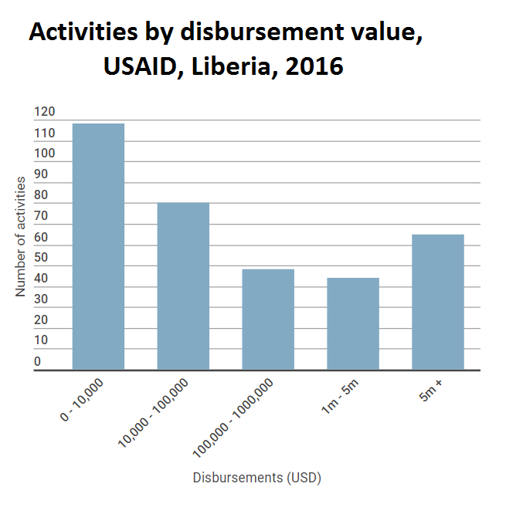
Challenge #1: Noise in the data

Slide 6
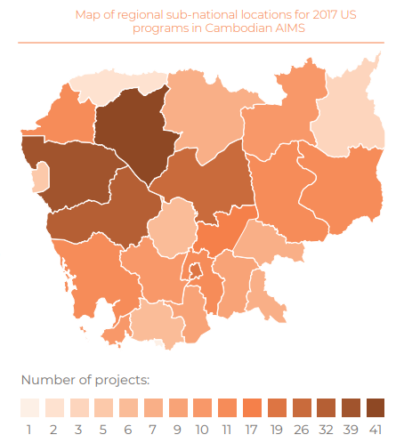
Challenge #2: Project level data
Activity Dates: Errors with activity dates. For example, in Cambodia the HARVEST program – which closed in 2015 – is listed as having closed in 2017.
Sector-Codes: For many activities IATI projects are coded with the most generic OECD-DAC CRS codes. For example, 100% of US agricultural programs in Cambodia were “agricultural development” or “agricultural policy”.
Sub-national locations:

Slide 7
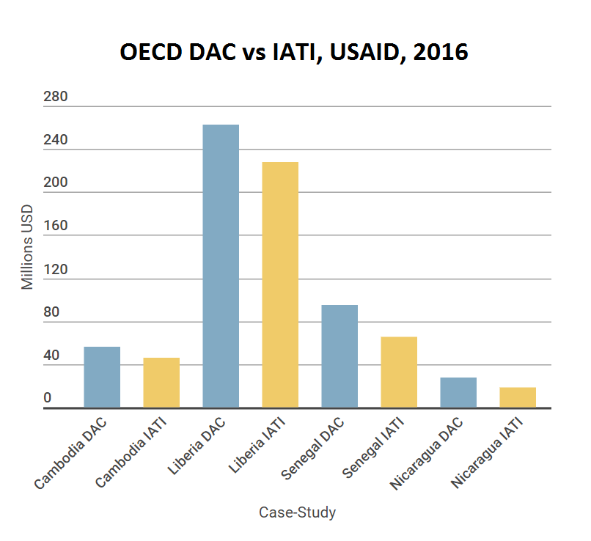
Challenge #3: Where’s the money?

Slide 8
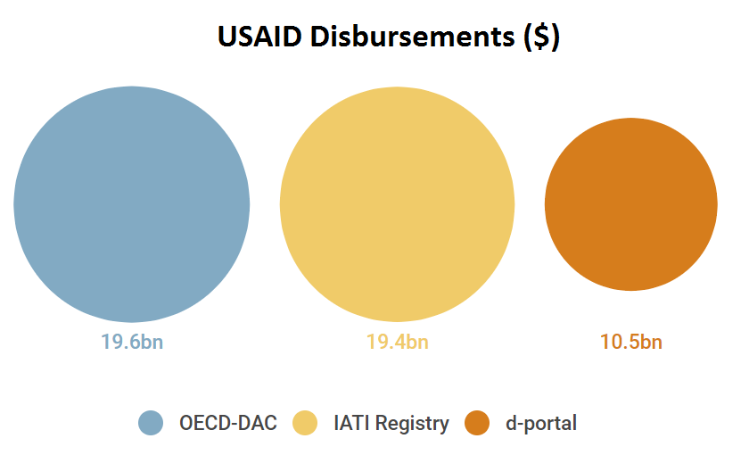
However...

Slide 9
How we provided feedback
Regular Check-Ins: Provided regular “informal” feedback through emails and calls.
2018 Aid Transparency Index: The Index process includes over three months of feedback and a final assessment on a range of indicators
US Transparency Report: An analysis of US IATI data for USAID, State, and MCC.

Slide 10
Some reflections…
Basic Data: Feedback gets stuck at the ‘basic data’ level.
Strong relationships: Our experience wouldn’t have been possible without the contacts / relationships we have with USAID. This isn’t a model that can be scaled-up.
Capacity Requirements: We have a strong understanding of IATI and without this, we would have struggled to provide feedback. Further, the provision of feedback is quite a long process and unlikely to be attractive for ‘casual users’.
Duplication? Some of the issues we highlighted were already known. Is there a way for the community to know what data quality issues have been acknowledged and are being worked on?

Slide 11
US Foreign Assistance Study
www.publishwhatyoufund.org/projects/us-foreign-assistance
@aidtransparency

Slide 12
Why does USAID need feedback?
Assists USAID in identifying issues
Low capacity to review data internally
Need validation when data is present but incorrect
Helps identify where USAID should focus resources
Builds case for larger structural changes
and investment
Notes:
Feedback is critical to improving USAID data quality and usability of our data. Even if we are unable to resolve an issue it is important for us to be aware of all issues and their effects.
The USAID IATI team does not have the capacity to review every single piece of data we publish. We depend on user feedback from internal and external users to improve.
As Andie mentioned in the introduction, USAID’s portfolio includes around 80,000 activities - limiting what our team can review and verify. Though all organizations likely have similar capacity issues -regardless of the size of the portfolio.
We also run into the issue that basic validation does not spot when data is present but not correct - this is why feedback is so critical to improving the data that we publish.
USAID needs to know what are the most important issues to resolve, and it would be helpful if users could help us prioritize by providing feedback so we understand where to best place resources for improving.
Tangible evidence helps push resource allocation to resolve issues.

Slide 13
Incorporating Feedback
Diagnose what is causing the error or issue
Identify a solution/s that resolves the issue
Implement solution/s to resolve the issue
Notes:
If USAID does receive feedback from the IATI community, there is three step process involved in incorporating this information.
First, we must discover what is causing the issue or error - is it a bug? Is it an issue with our internal process? Is the error in the XML or is it something with the ingestion into a visualization tool like d-Portal?
Next, we must find all the possible solutions to an issue and research their implications.
What we do not want to do is institute a “fix” only to watch it affect other parts of the data or produce issues downstream.
This is where the Discuss Forum or this community comes in to play - being able to bounce ideas off of others is critical in this environment
Finally, if possible, we socialize the changes with institutional decision makers at USAID, implement a solution or multiple solutions.

Slide 14
Incorporating feedback: Diagnosis
Issues arise from 3 causes:
Technical Issues – caused from procedural errors during processing and reporting
Data Issues – due inherent to the data or intentional built into the data processing
External Issues - External sites or tools are causing an issue
Notes:
Diagnosis is usually the most straight forward step.
From analysis and prior feedback, we know we can break feedback into two buckets that we are responsible for: technical issues and data issues
The third diagnosis is that the feedback is centered on an issue in a visualization tool - for example, d-Portal, and all our team can do is reach out to the owner of the visualization tool and see if we can encourage a remedy. Because this one is a bit out of our hands, today, we’ll just focus on the first two issues.
Technical Issues include Harder to diagnosis, but identification and implementation easy.
Technical issues arise when there is an issue in the processing and or reporting of our data - for example, my data program missed a step or the XML has a bug or a coding error.
Data Issues: Often easy to diagnosis, oftentimes already aware of the issue, but next steps are more difficult.
Data issues include things like the descriptions we are publishing contain too many acronyms or we are limited by a U.S. Government sector in our systems and aren’t capturing data at a more granular level.

Slide 15
Incorporating Feedback: Solution Identification
Can we resolve this issue? Are there partial fixes?
Are there different short term or long term solutions?
Will a solution cause other issues to resolve?
Notes:
The next step is to analyze the information available and identify possible solutions.
It is important to first understand if this is an issue USAID can fix.
If there are, instead of jumping into a solution, first, we must analyze a few different solutions and look at all possible alternatives, and ensure that all implications of a solutions been identified
We also have to be careful to not institute a “fix” that produces issues downstream. Will another issue arise?
We can examine if there are solutions that will mostly fix the problem, if there solutions that can immediately be put in place, and if there are there longer term, solutions that should be started
Our team has historically relied on the broader IATI community to help support this effort.
While we are grateful - it would be helpful to think about IATI providing guidance and more materials to publishers in this regard.

Slide 16
Incorporating Feedback: Implementation
Do we have the capacity to implement a solutions?
Is it worth implementing?
How do we implement the change?
How do we socialize and communicate the update in the data?
Notes:
Finally, we have to ask if USAID have the bandwidth to take on this solution? Does it have to wait? Are there enough resources?
Is it worth diverting resources and using time to fix a particular issue? Should those resources be used elsewhere?
In many instances, the answer is yes - and we do end up implementing a fix or a change in our data.
To do so, however, we have to think about how we go about implementing the change or the fix - this is particularly important in large and bureaucratic organizations
Are all clearances in place?
Are clear lines of responsibility for the fix established?
Is this something we will need to remember to do on an ongoing basis or continue working on?
Finally, we have to think about how we socialize and communicate the change
This might entail socializing the change internally, working with USAID staff to collect a specific piece of information differently, or shifting responsibilities
We also have to communicate the change effectively to those who provided us with the feedback in the first place and sometimes also with internal data users.

Slide 17
Example 1: Noise in Data
Feedback: There are many small, generic “activities” that obscure larger, more prominent USAID activities
Diagnosis: Inherent in the flat business structure of USAID’s financial system
Identification: Aggregate small generic activities together to reduce total number of activities
Implementation: Create a set a business rules that identifies noise creating activities and removes unique identifying information
Notes:
This is an example of a Data issue
Additionally, this is a good example of where the data is there, but traditional validation efforts are not sufficient to catch this issue. Being ‘there’ does not make the data usable.
In this example, we received feedback that USAID’s Activity lists on d-portal and other reporting sites are often filled with many small dollar “activities” that make finding larger activities more difficult. In many cases this might be operating expenses or small financial transactions that are appearing as an activity, but aren’t what most data users would consider meaningful.
The diagnosis here is that the way USAID’s financial system collects data is flat
The business structure of USAID is flat with no inherent hierarchy.
Small procurement activities are reported at the same level of large multi-million dollar activities.
Identification: Next, we identified small activities that remove unique identifying information so they can be aggregated together reducing the total number of activities and leaving the larger activities.
The transactions and spending still is reported, but the activities are no longer reported individually.
Implementation: Create a set of business rules using USAID activity ID’s and funding accounts to identify small administrative and procurement activities that can be safely aggregated without a significant loss of information for the user.
We cleared this solution through the Agency, socialized it, and then began producing data with the new business rules applied.

Slide 18
Example 2: Inaccurate Dates
Feedback: Activity start and end dates are often inaccurate
Diagnosis: Inaccurate or incomplete reporting in USAID’s internal systems
Identification:
1) Attempt to fix inaccurate dates
2) Improve data collection
Implementation: Identify activities with obligations past the reported end date and extend the end date.
Notes:
This is an example of where the data just is not there - USAID does not have this information in a reliable system of record.
In this example we received feedback that many users are frustrated that USAID’s start and end dates are inaccurate. They do not reflect the actual dates of an activity.
This is also a data issue diagnosis as USAID depends on multiple internal systems to report activity dates.
Inaccurate reporting occurs when the dates are entered incorrectly, not updated, or do not reach the proper system for our team to utilize.
The identified solution for this example is a good example of short term vs. long term solution.
We have two options that are not necessarily exclusive.
In the short term, we can attempt to fix inaccurate dates and generate activity dates using a set of reasonable business rules.
In the long term, we can encourage better data collection with updated systems and trainings for USAID staff on how to best input data into the system.
Implementation: We implemented the short term solution, but we are concurrently making sure that the longer term solution is moving forward through the roll out of our internal project management system and communications with USAID staff.

Slide 19
Example 3: Missing Portfolio
Feedback: USAID is missing a significant part of its portfolio on d-Portal
Diagnosis: Activity ID’s that appeared across multiple country XML’s and being dropped on D-portal
Identification:
1) Make activity ID unique across files
2) Move aggregate activities under one file
Implementation: To be determined
Notes:
This final example is an on-going issue that is yet to be resolved.
It is also an example of where the challenge is how you use IATI data.
We recently received feedback that nearly 6 billion of USAID’s 19 billion portfolio was missing from d-Portal.
This took us some time to diagnose, and eventually was diagnosed by an outside individual - which is why the IATI community is so important!
What was happening is that USAID reports the same IATI activity ID across country files.
This happens when USAID has an activity that is in multiple countries or regions.
For example, let’s say there is a large health activity that is managed out of Washington in a central activity that all of our mission teams can buy into - this happens more often than you’d think in USAID’s data, and it presents a problem for our IATI publications
Here, what we diagnosed is that when an activity is in multiple countries or regions, D-portal drops all transaction after the first country file.
Identification: There are two primary solutions:
Add a country or region code to the activity ID to make them unique
Or re-arrange the activity files so that all transactions are in one file and the country code is reported as the transaction level.
In this example, our team is still in the identification stage.
We need to consider ramifications of changes.
It will be more harder to identify an activity that has different activity ID’s.
Re-structuring our files so that all transactions of one recipient are not necessarily in one file with disrupt usage of our data by AIMS IATI importers - which we obviously do not want to happen.
Implementation: We are still trying to find the best solution for this issue.

Slide 20
Summary
Feedback:
Is the most effective way to flag issues in IATI data
Is most useful when centered on actual use rather than binary assessments
Can be difficult to address
IATI is complex and fixing issues can create new issues
IATI guidance and support could help address some of these issues
Notes:
To conclude:
Feedback is perhaps the most effective way of flagging problems
Feedback which centre on actual use are more valuable than binary assessments, as it helps focus your attention on the hurdles users hit first rather than spewing out a mass of errors to address at some point
Addressing feedback isn't as straight-forward as some might think. There can be a lot of behind the scenes work (i.e. activity dates).
Sometimes challenges arise purely out of the complexity of IATI -- it's not always clear what the IATI solution is (as in how to code it) and you have in the past fixed one issue only to create another one (whack-a-mole).
IATI guidance / support could be one resolution.
(However, if you make point re: the need for IATI support to be better then you will need some examples in your pocket just in case anybody asks). - DARREN DO YOU HAVE EXAMPLES

Slide 21
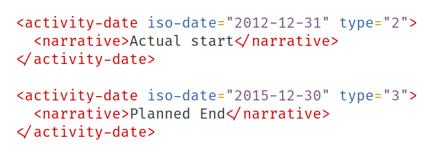

Slide 23
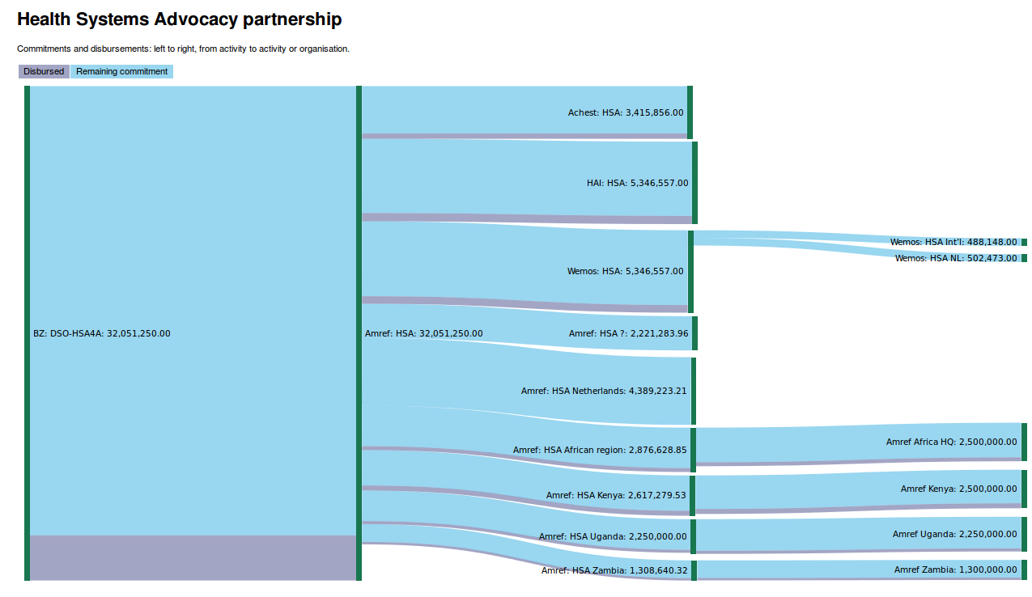
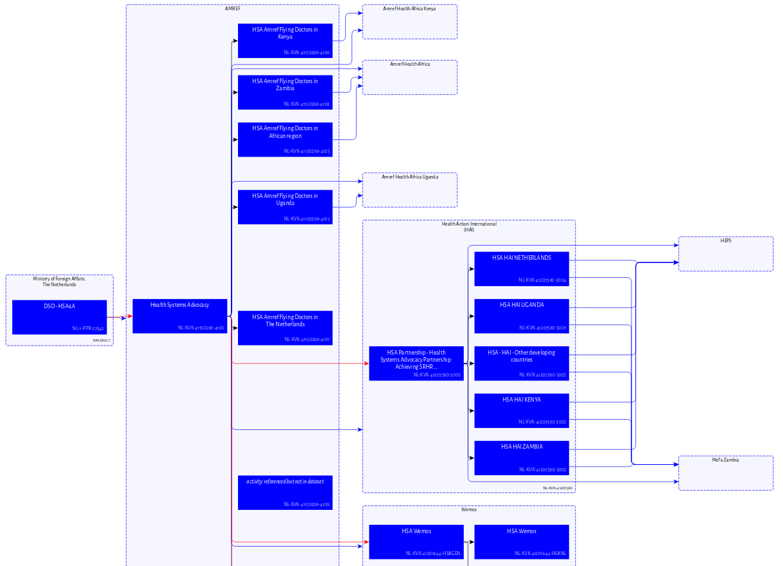

Slide 24
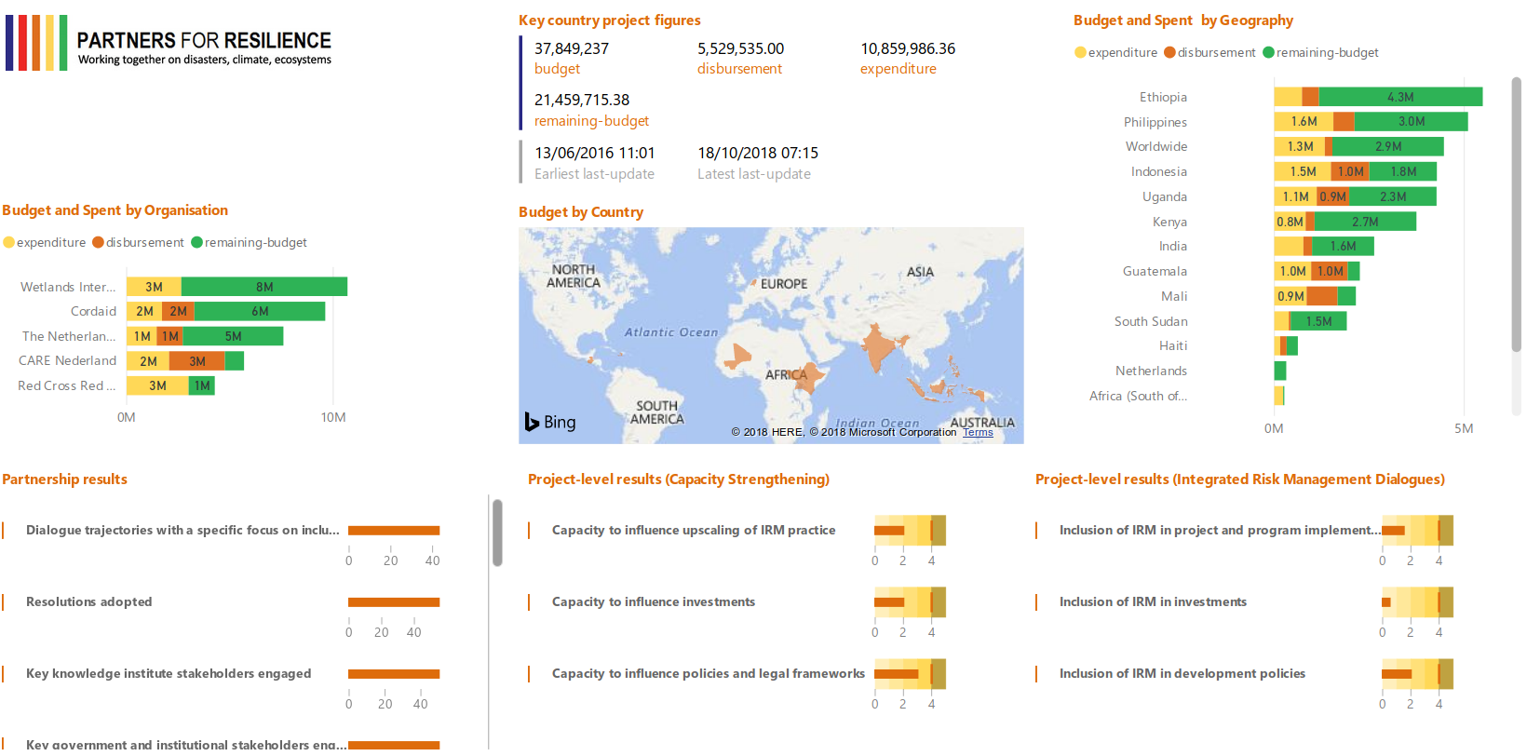

Slide 25
Who wants the feedback?
Programme staff
Programme managers
Application managers
What do they want to know?
Is my data ok?
Does the data meet the donor’s requirements?
Is everyone publishing the right information?

Slide 26
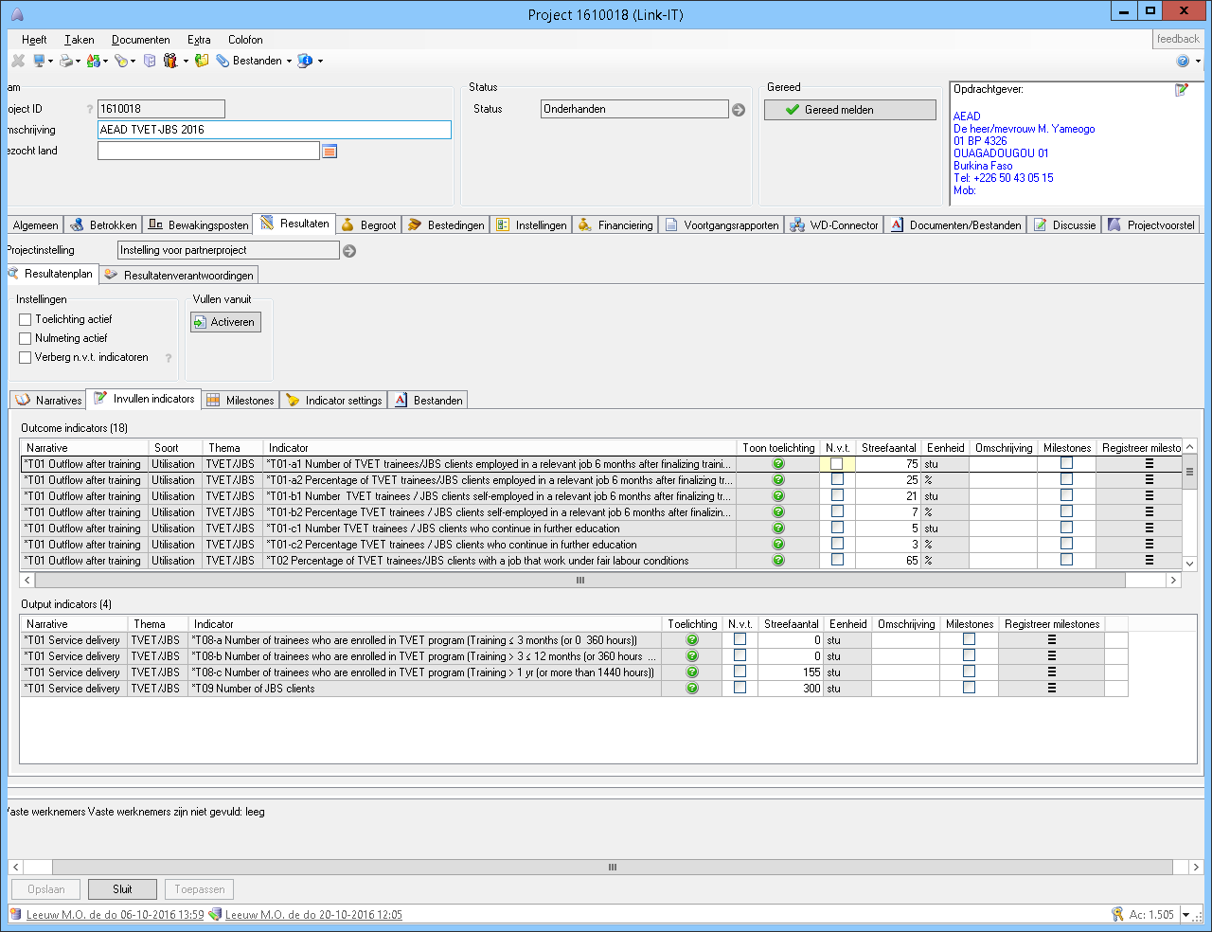

Slide 27
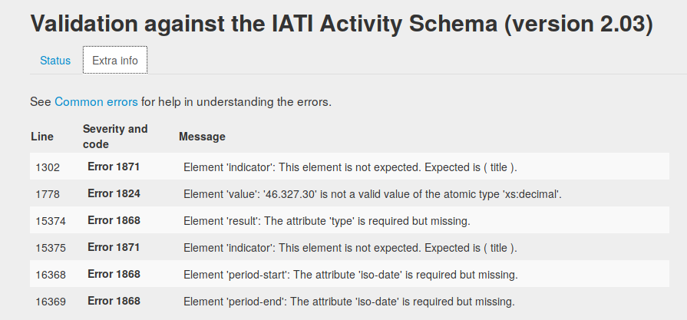

Slide 28
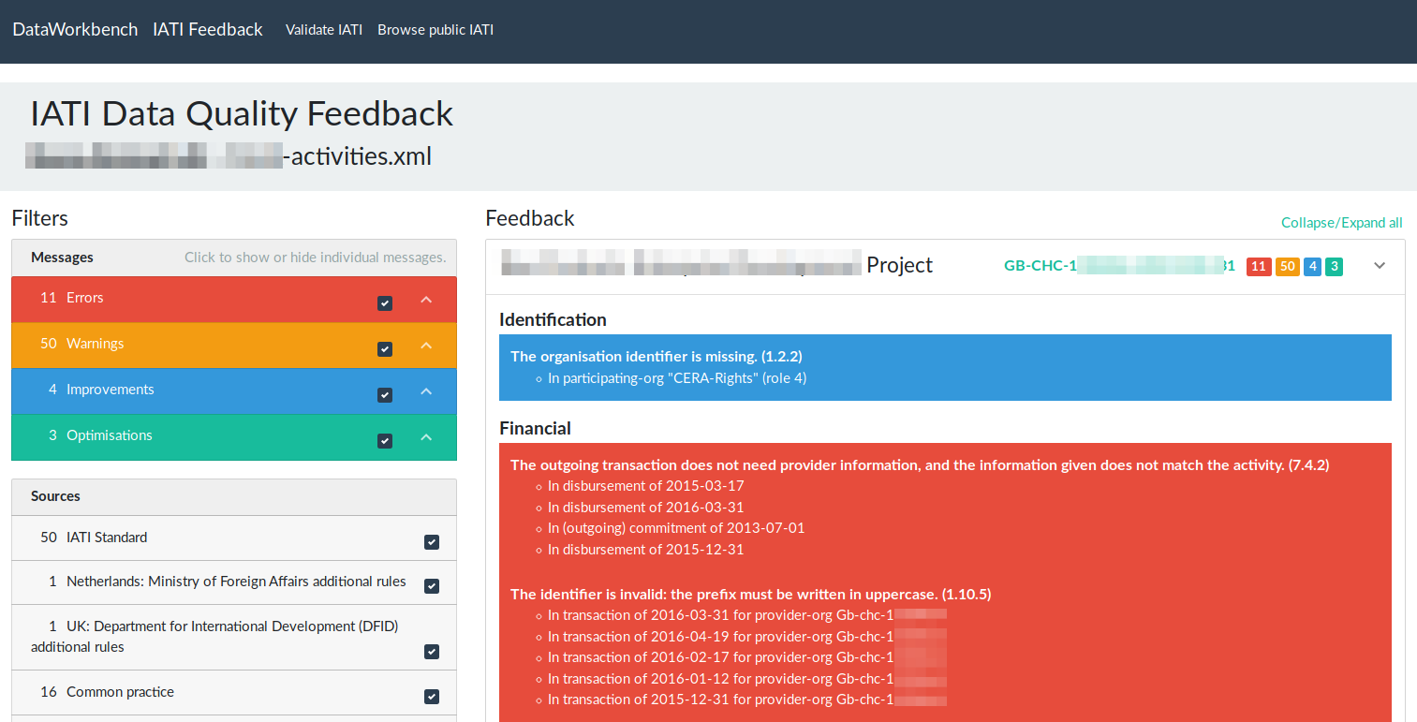

Slide 29
www.dataworkbench.io/iati-feedback
www.dataworkbench.io/process/get-feedback?url=<your data>
https://hub.docker.com/r/data4development/iati-data-validator/

Slide 30
Feedback for who?
Technical staff
Dates off-by-one
Codelists
Identifiers
Programme staff
Dates are wrong
Mistyped numbers
Missing countries, indicators, etc
Programme managers
Activities are missing
Results are not up-to-date

Slide 31
Group Break-Out
Questions - Feedback

Slide 32
Group Break-Out
What feedback is most valuable for publishers?
What are the most sustainable ways for users to provide feedback?
How can publishers actually incorporate and prioritise feedback?
How can publishers share what they are working on?

Slide 33
Bring Back Together
Discuss findings
Q&A

