Slide 1
IATI within the humanitarian context
The need for data
Wendy Rogers & Steven Flower
13 November 2018 IATI TAG Nepal

Slide 2
Welcome and introductions
Wendy Rogers
Senior IATI Business & Data Analyst
Grand Bargain Transparency
Development Initiatives
Steven Flower
IATI Consultant
GB IATI-FTS Pilot Coordinator
Open Data Services Co-operative

Slide 3
The Humanitarian Context
Increasing number of protracted and rapid onset humanitarian emergencies are overwhelming an aging humanitarian system.

Slide 4
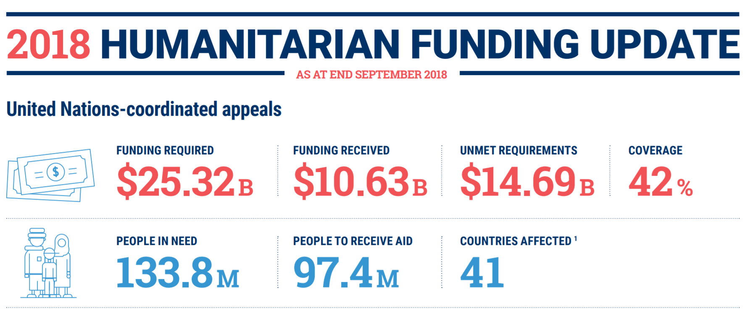
Source: https://reliefweb.int/report/world/humanitarian-funding-update-september-2018-united-nations-coordinated-appeals-enar

Slide 5
The Grand Bargain was born
Agenda for Humanity
World Humanitarian Summit 2016
Grand Bargain
agendaforhumanity.org
The humanitarian community comes together to try and decide on how to
improve the humanitarian systems. The Grand Bargain is ultimately established to
drive change & improve the system.

Slide 6
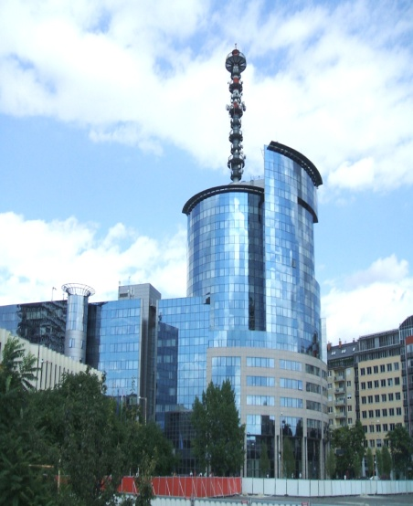
Humanitarian Sector - FTS & IATI
(I)NGOs / Fund
Managers / Private
Sector
In Country
National / Local
NGOs
Affected
Population
Donors / Investors
IATI DATA
NEEDS
DATA
UN OCHA
Response
Coordinator
Parliamentarians / Tax Payers / CSOs /
Auditors / Researchers / Media etc
In Country
Govt. Ministrys

Slide 7
Grand Bargain Original Workstreams
Greater transparency (Netherlands & World Bank)
Localisation: More funding for local & national responders (Switzerland & IFRC)
Cash: Increase the use and coordination of cash-based programming (UK & WFP)
Reduce duplication and management costs (Japan & UNHCR)
Improve joint and impartial needs assessments (ECHO & UN OCHA)
A participation revolution: include people receiving aid in making the decisions which affect their lives (USA & SCHR)
Increase hum. multi year planning (Canada & UNICEF)
Earmarking: Reduce the earmarking of donor contributions (Sweden & ICRC)
Harmonise and simplify reporting requirements (Germany & ICVA)
Enhance engagement between hum. and dev. actors (UNDP & Denmark) (NB Workstream now mainstreamed)

Slide 8
Grand Bargain Transparency Workstream – work to date
Within the GB Transparency workstream we have been working with GB signatories to:
Increase their awareness of IATI and its potential
Enhance the IATI Standard so that it is more relevant to humanitarian organisations
Encourage publishing to IATI using the specific humanitarian features of v2.02 or later of the IATI standard
Working wth UN OCHA FTS so that it can automatically import IATI data into its Financial Tracking Service (FTS).

Slide 9
Impact
 | Baseline report 1 June 2017 (51 signatories) | Analysis Sept 2018 (59 signatories**) | Change since baseline assessment
Publishing open data using IATI | 37 organisations* (73%) | 46 organisations (78%) | Additional 9 organisations
Of these
Publishing data on their humanitarian activities | 31 organisations (84%) | 41 organisations (89%) | Additional 10 organisations
Using v2.02 of IATI or later | 16 organisations (43%) | 36 organisations (78%) | Additional 20 organisations
Providing more granular data | - | 10 organisations (22%) | 10 organisations
* Or their members or affiliates *** includes 3 non publishing signatories – NEAR, ICVA & SCHR

Slide 10
How transparent are the world’s largest humanitarian donors? (Sept 2018)
Donor (USD m) | Publish to IATI? | Publish human-itarian data? | Use v2.02? | Publish granular data?
1. US (6,683) | ✔️ | ✔️ | ✔️ | ✔️
2. Germany (2,988) | ✔️
3. UK (2,518) | ✔️ | ✔️
4. EU (2,247) | ✔️ | ✔️ | ✔️ | ✔️
5. Japan (843) | ✔️ | ✔️
6. Sweden (767) | ✔️ | ✔️ | ✔️ | ✔️
7. Canada (568) | ✔️ | ✔️
8. France (682) | ✔️ | ✔️
9. Norway (653) | ✔️ | ✔️
10. Netherlands (569) | ✔️ | ✔️

Slide 11
Grand Bargain Transparency Workstream – next phase
Within the GB Transparency workstream we are currently working to
Demonstrate how IATI data can be used to answer some of the questions both within and beyond the Grand Bargain and establish longer term capability sustainability as required.
Encourage GB signatories to publish the data that is ‘useable’ rather than just meeting a data quality benchmark and to use their own and others available data.
Continue working with UN OCHA FTS so that it can automatically import IATI data into the Financial Tracking Services (FTS).

Slide 12
How IATI data can help
IATI can potentially provide the data (assuming it is published) for some of the Grand Bargain’s required baselines measures (via FTS?)
Where & how much is cash programming is being used and by which organisations? (ws3 - cash tracking)*
Provide easy accessibility to details of individual humanitarian projects results data (ws9 – harmonised reporting)
What has an intervention spent its money on and achieved? Was it successful and value for money? (ws9 -harmonised reporting)?
How much funding is actually being channelled directly to local and/or national actors. Are signatories meeting the 25% commitment of ‘direct’ funding? (ws2 - localisation) *
A combined view of all development and humanitarian funding and activities for a region or country or other location (ws10 - hum-dev nexus)

Slide 13
Beyond the Grand Bargain & FTS
These are other real world humanitarian related questions or enquiries where IATI data could potentially be exploited
In rapid on-set emergencies, are pledges* being honoured with the actual funding of promised assistance?
Can we track that pledges* made to specific appeals are being honoured eg Berlin Lake Chad / London Syria conferences. Are pledges ‘new money’ or pre-committed funding?
What actual activities are being carried out by organisations in response to a crisis or emergency*
Access to financial summaries of smaller crisis that are not ‘tracked’ by OCHA

Slide 14
Any questions?

Slide 15
Humanitarian Sector - FTS & IATI
Donors / Investors
(I)NGOs / Fund
Managers / Private
Sector
In Country
National / Local
NGOs
Affected
Population
EDRIS
IATI DATA
FTS
NEEDS
DATA
UN OCHA
Response
Coordinator
Parliamentarians / Tax Payers / CSOs /
Auditors / Researchers / Media etc

