Slide 1
Publishing and Communicating IATI Data with Akvo RSR
IATI TAG 2018
Kathmandu, Nepal

Slide 2
Akvo is a not-for-profit foundation that creates open source, internet and mobile software and sensors
Akvo helps people use data, to transform international development

Slide 3
Akvo RSR
An online communication, reporting and monitoring hub for all your projects to openly and pro-actively communicate project data and results
https://rsr.akvo.org/

Slide 4
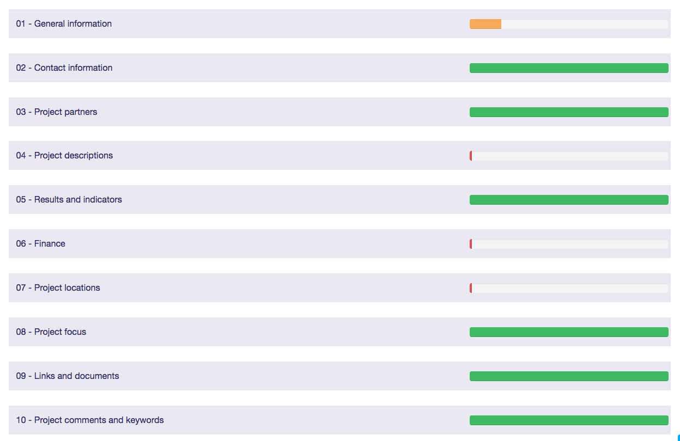
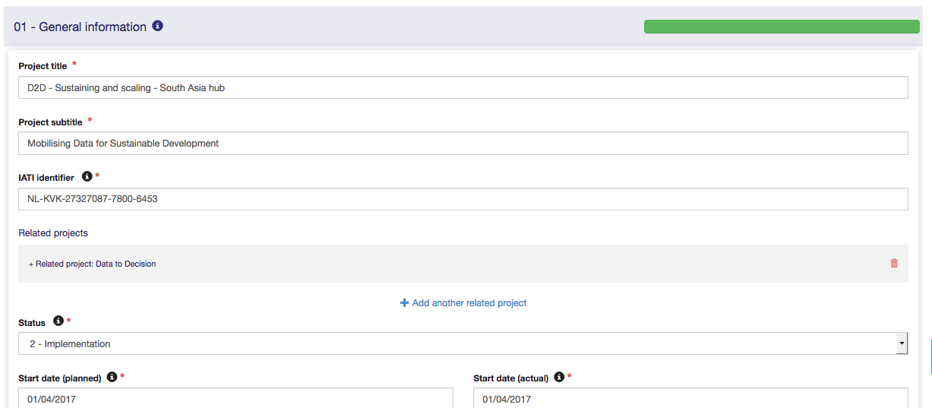
Project editor
data categories
Project editor

Slide 5
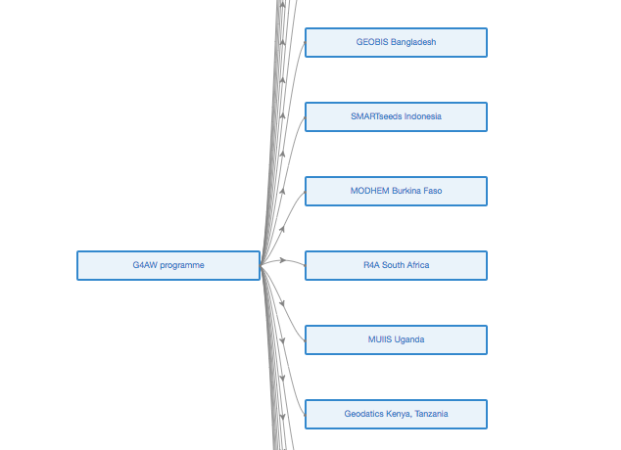
Project hierarchy, Parent & Child RSR Project Pages

Slide 6
IATI results data structure
Results: your project outputs, outcomes and impact
Indicators: how will these results be measured
Reporting periods: how often will you update indicators
Baseline values
Target values
Actual values
Comments
Disaggregation
Qualitative
Approval workflow
unit or % (numerator/denominator)

Slide 7
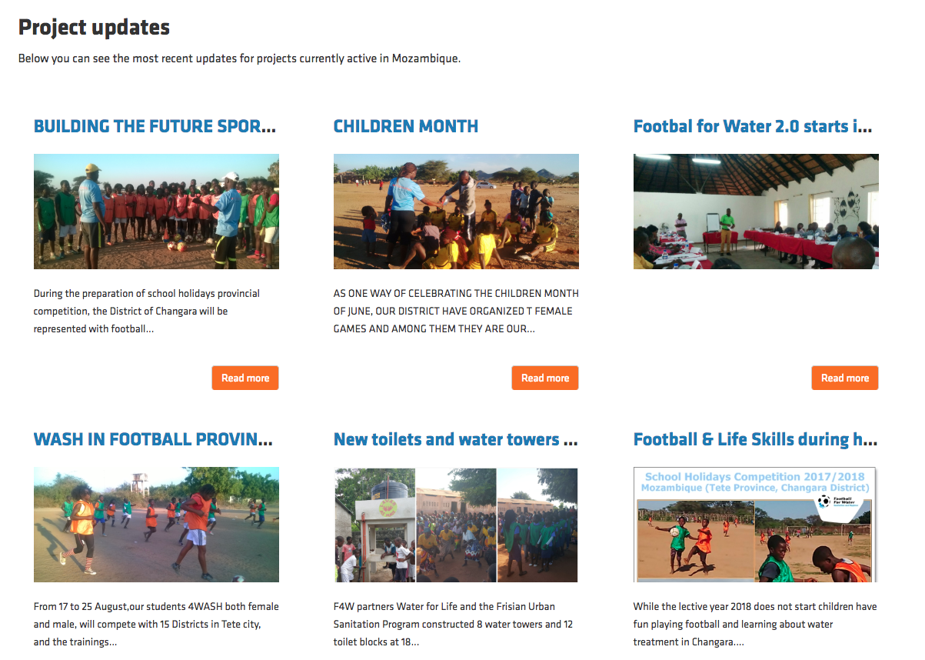
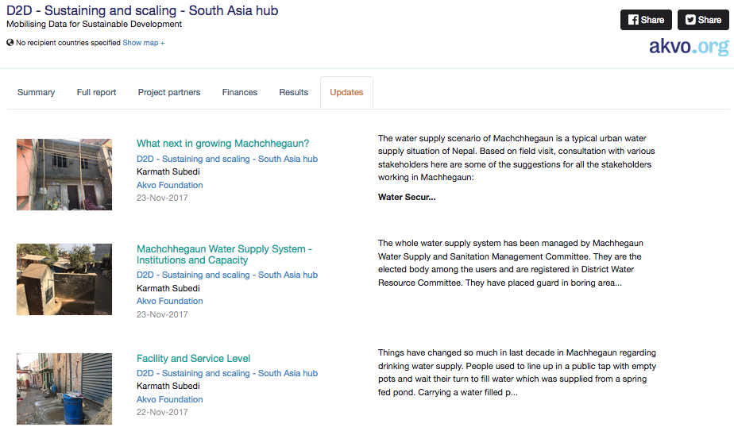

Slide 8
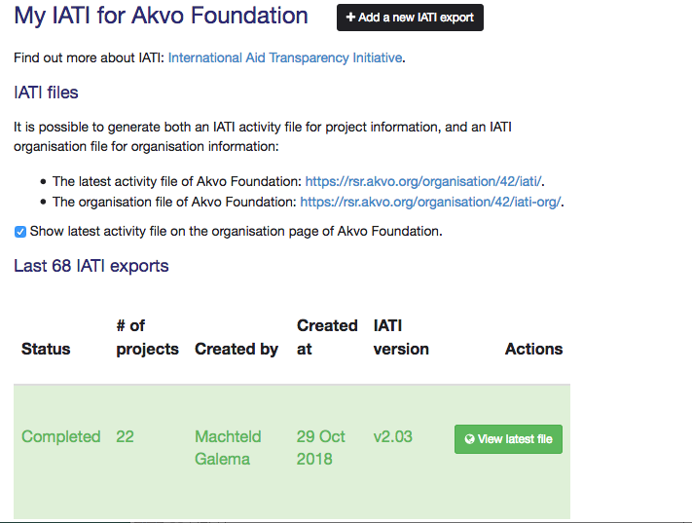
Akvo RSR IATI publication
Iatiregistry.org
More information on Akvo RSR: https://akvo.org/products/rsr/

Slide 9
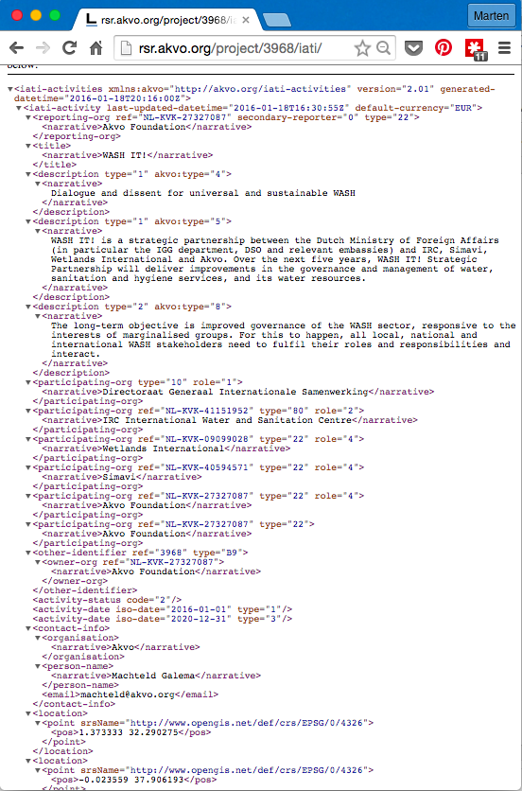
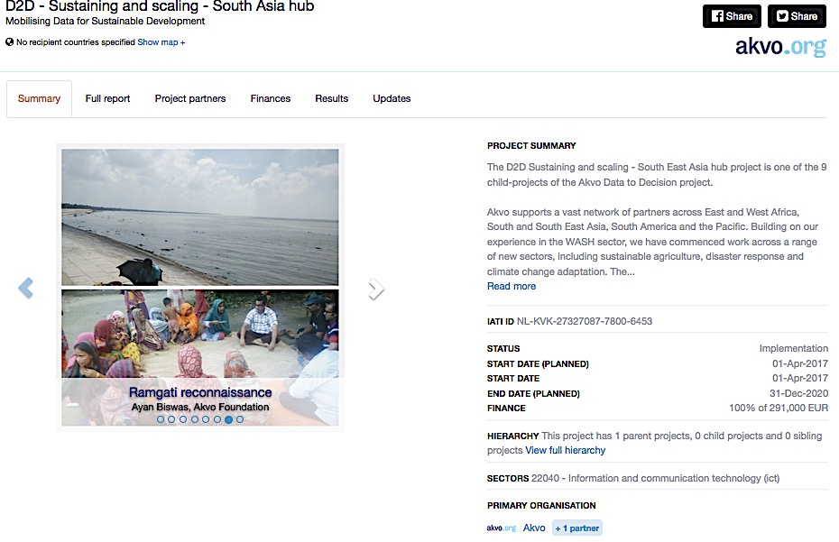
The same data:
In IATI xml
On an Akvo RSR project page

Slide 10
Examples of RSR Projects using IATI

Slide 11
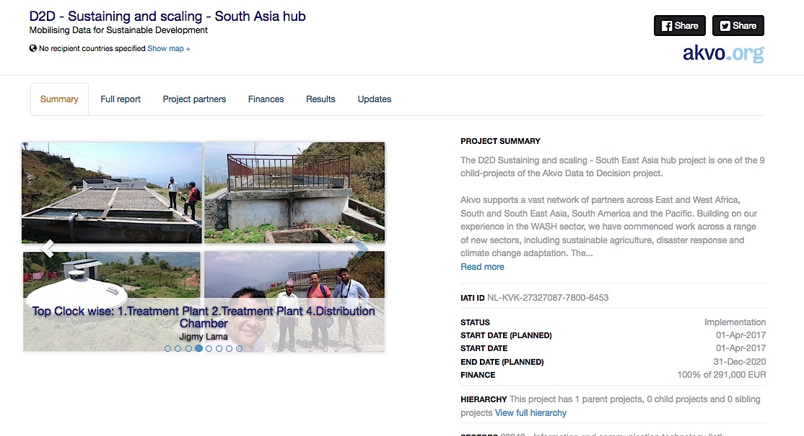
Example of use at programme level: From Data to Decision
This programme will focus on improving knowledge management, innovation and monitoring. In practice, this means working with new and existing partners to increase the quality and consistency of available WASH data; to ensure these data can be rapidly transformed into credible and actionable information for decision-making; and, where appropriate, to create platforms and protocols for information and knowledge sharing.

Slide 12
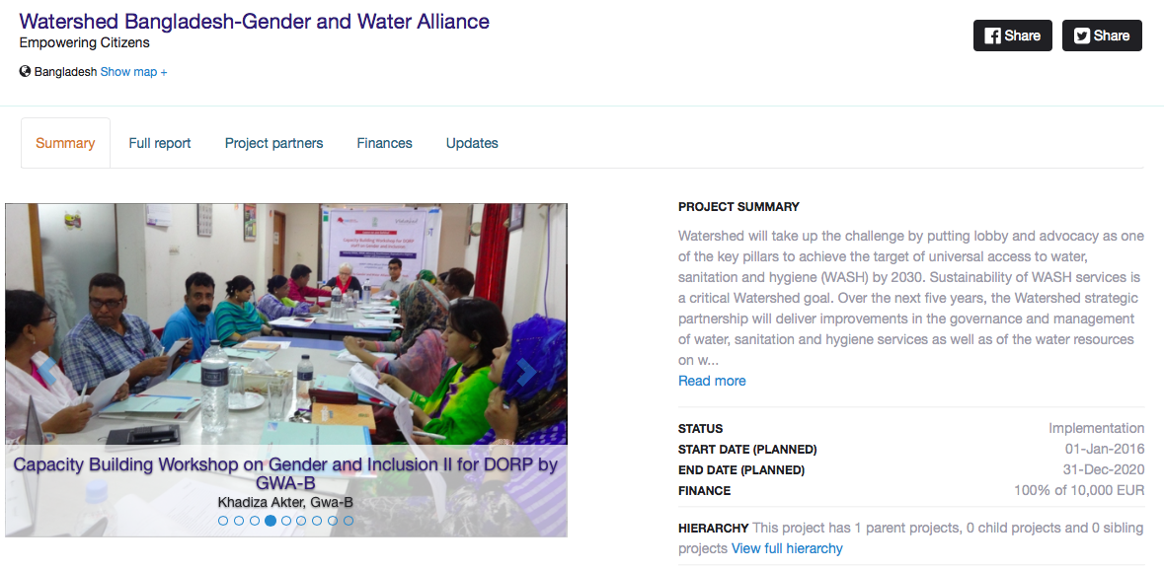
Example of use at programme level: Watershed
The Watershed programme is involved in a number of projects with a variety of partners, with different funding mechanisms and with different life spans. All projects are contributing to the measurable improvements in the quality and sustainability of WASH services in these countries.

Slide 13
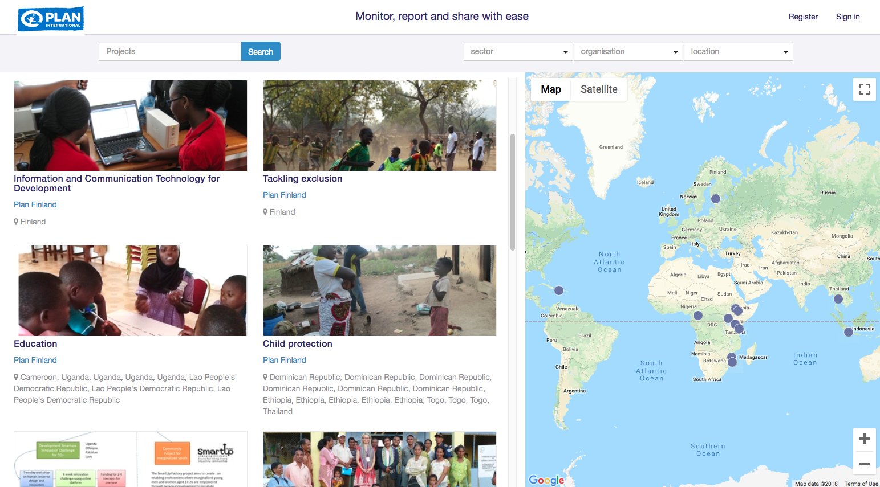
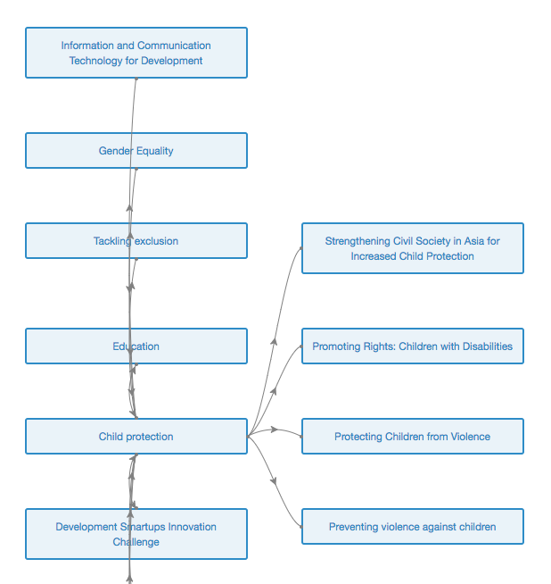
Example of use on organisational level: Plan Finland
Plan Finland: “Development funds are precious and we, as development organisations, have a moral responsibility to organise our work as well as we can and overcome any waste. IATI is a tool to improve coordination.”
Share all programmes and projects transparently
Ensure it can be easily accessed online using RSR: https://planfinland.akvoapp.org/en/projects/
Helping others to decide how to benefit from IATI:
business case framework

Slide 14
Thank you
For more information,
Visit: akvo.org
Email Us: jigmy@akvo.org, karmath@akvo.org, marten@akvo.org

