Slide 1
Convert (flatten) IATI XML file to CSV file(s) using XQUERY
Ibrahim Aboalfadl Omar
TAG2018, Kathmandu

Slide 2
Why XQUERY?
WIKIBOOKS says:
The principal benefits of XQuery are:
Expressiveness - XQuery can query many different data structures and its recursive nature makes it ideal for querying tree and graph structures
Brevity - XQuery statements are shorter than similar SQL or XSLT programs
Flexibility - XQuery can query both hierarchical and tabular data
Consistency - XQuery has a consistent syntax and can be used with other XML standards such as XML Schema data types
XQuery is frequently compared with two other languages, SQL and XSLT

Slide 3
BaseX: A Tool used to run XQUERY
BaseX is a robust, high-performance XML database engine
Simple and easy to run XQUERY script
Highly compliant XQuery 3.1 processor
Open source
Lightweight
It comes with interactive user interfaces (desktop, web-based) that give you great insight into your data.

Slide 4
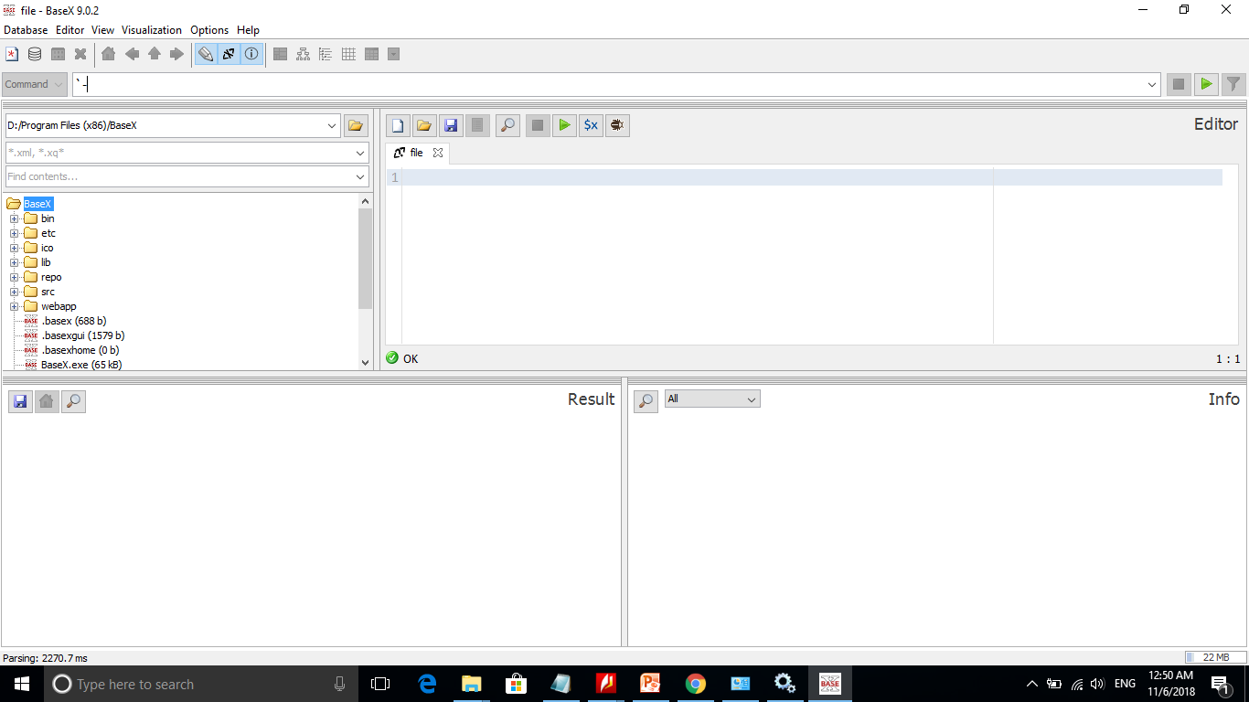

Slide 5
IATI XML FILE

Slide 6
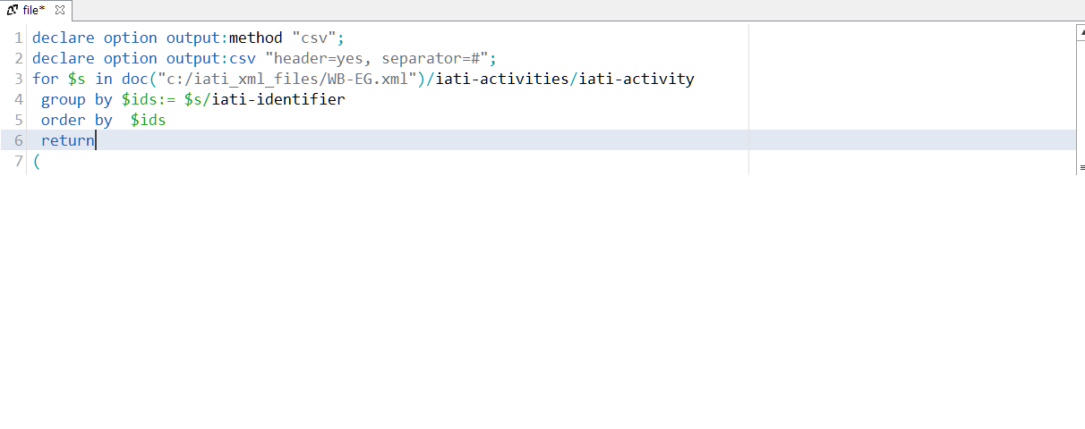
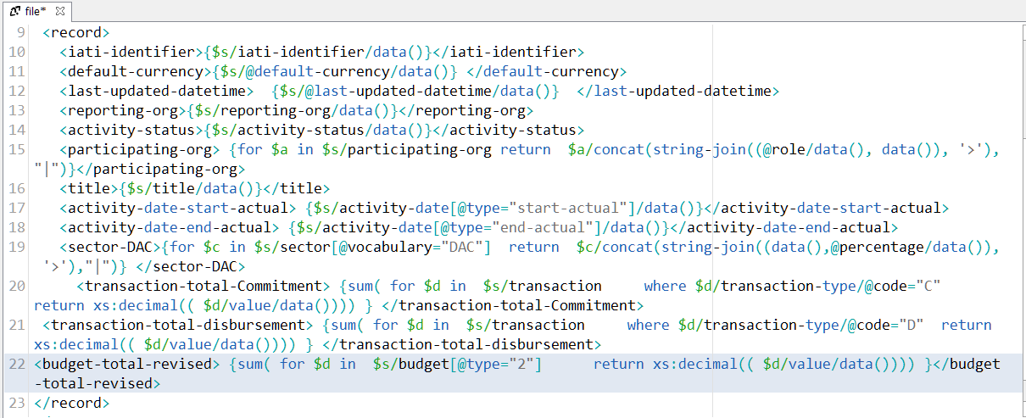
The Script

Slide 7
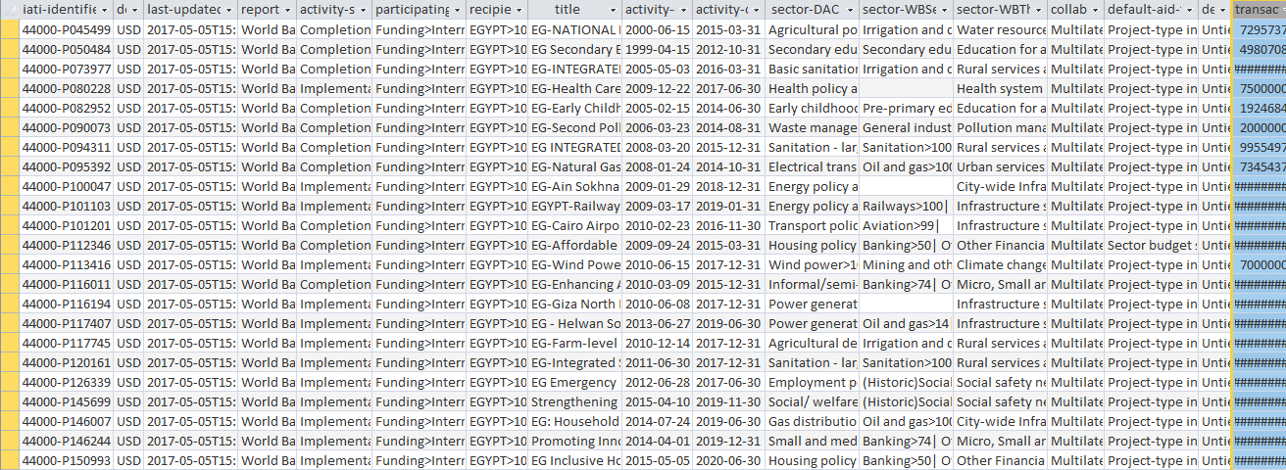
Imported CSV File

Slide 8
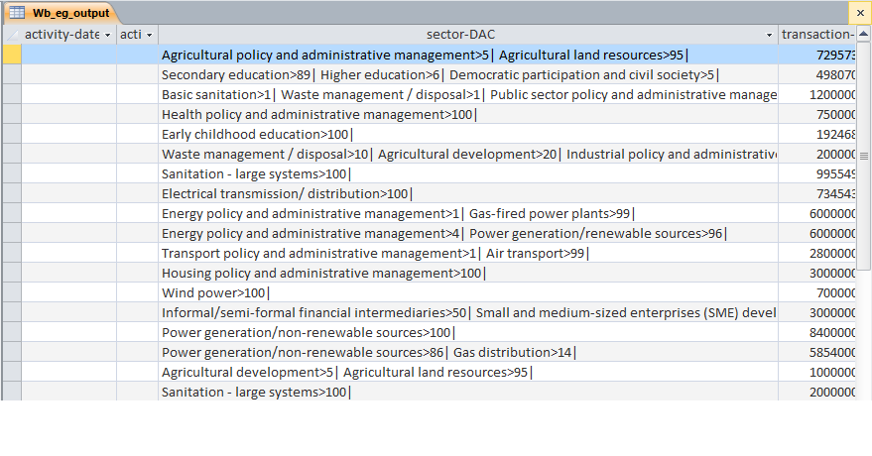
Imported CSV File

Slide 9
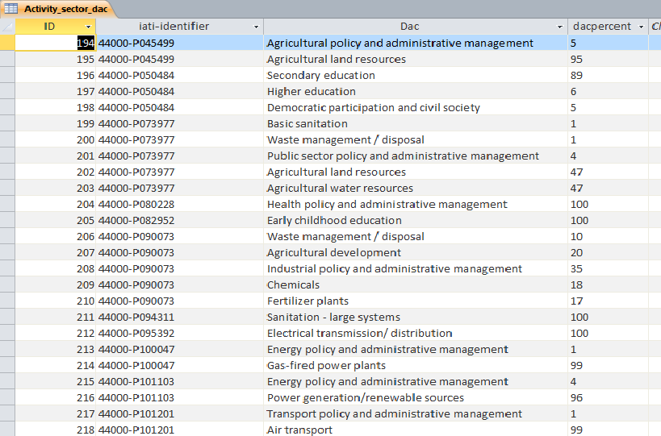
Imported CSV File, DAC column striped to a new table records

Slide 10
Conclusion
Use XQUERY to get the data of a tree item in one concatenated column separated each value with “|” sign and if the value has a descriptor separate them by “>” sign, or use any other sign.
Import the generated CSV file in a Database or spreadsheet
Strip the concatenated column to be converted into multiple columns or rows

Slide 11
Thank You

